Slide 1


School of Computer Science & IT Department of BCA
INTRODUCTION TO LINUX(20BCA1C06)
MODULE 1: INTRODUCTION TO LINUX COMMANDS
Faculty : Dr. Ananta Ojha

Slide 2
Session -1
Syllabus Introduction
Why do we need to study Linux?
Overview of Operating System
Introduction to Multiuser OS
Unix Operating System

Slide 3
Syllabus
Title | Introduction to Linux
Code | 20BCA1C06
Hrs / Week | 4 Hrs
Credits | 4
Course Outcomes :
At the end of the course, the students will be able to:
CO1: Explore the basic UNIX commands with its usage.
CO2: Use UNIX file system and different system calls in files.
CO3: Analyze the working of processes in UNIX operating system.
CO4: Demonstrate the simple shell scripting with VI editor.
CO5: Use the system administrative skills in Linux operating system.

Slide 4
Module-1
Module -1 14 Hrs Introduction to Linux commands Introduction to Multi user System, History of UNIX, Features & Benefits , Versions of UNIX, Features of UNIX File Commonly Used Commands like who, pwd, cd, mkdir, rm, rmdir, ls, mv, ln, chmod, cp, grep, sed, awk ,tr, yacc etc. ystem Getting Started (Login/Logout) Creating and viewing files using cat, file comparisons, View files, disk related commands, checking disk free spaces. Introduction to various Linux flavors, Debian and rpm packages Vendors providing DEBIAN & RPM distribution & Features; Ubuntu History, Versions, Installation, Features, Ubuntu one; Fedora: History, Versions, Installation, Features.

Slide 5
Module-2
Module -2 10 Hrs The UNIX File System: Inodes - Structure of a regular file, Directories, Conversion of a path name to an inode Super block, Inode assignment to a new file, Allocation of disk blocks. System calls for the file System: Open, Read, Write, Lseek, Close File creation -Creation of special files Changing directory and root , changing owner and mode Stat and fstat, pipes, Dup, Mounting and Unmounting file systems, Link and Unlink.

Slide 6
Module-3
Module – 3 16 Hrs VI Editor: Introduction to Text Processing, Command & edit Mode Invoking VI, deleting & inserting Line; Deleting & Replacing Character; Searching for Strings, Yanking, Running Shell Command Macros; Set Window, Set Auto Indent, Set No. Communicating with Other Users: who, mail, wall, send, mesg, ftp. Shell Script: : Shell types, shell command line processing. Shell script features; Executing a shell script System and user-defined variables, expr command, shell screen interface, read and echo statement, command substitution, escape sequence characters, Conditional Control Structures-if statement, case statement Looping Control Structure while, until, for, statements. Jumping Control Structures – break, continue, exit.

Slide 7
Module-4
Module-4 8 Hrs UNIX Process Management The Structure of Processes: Process States and Transitions Layout of system memory Context of a process. Process Control: Process Creation Signals – Process Termination Invoking other programs PID & PPID – Shell on a Shell.

Slide 8
Module-5
Module-5 12 Hrs System Administration Common administrative tasks Identifying administrative files configuration and log files Role of system administrator, Managing user accounts-adding & deleting users, changing permissions and ownerships, Creating and managing groups, modifying group attributes, Temporary disabling of user’s accounts, creating and mounting file system, checking and monitoring system performance File security & Permissions, becoming super user using su. Getting system information with uname, host name, disk partitions & sizes, users, kernel Installing and remoVIng packages with rpm command.

Slide 9
Activities
Activity-1: Do a research and prepare presentation on hardware, software, and information requirement for the installation of different flavors of Linux.
Activity-2: Online certification on Introduction to Linux.
Activity-3: Case Study: Prepare a report on case studies given by teacher relevant to various activities performed by system administrator.

Slide 10
Text Books:
Maurice J. Bach, The Design of Unix Operating System, (2010) Pearson Education
Unix Concepts and Applications, Sumitabh Das, 2010
The UNIX Programming Environment, B.W. Kernighan & R. Pike, Prentice Hall of India. 2009

Slide 11
Why do we need to study Linux?
It is Free and Open Source
You can modify to cater your requirements
Runs on any Hardware
Linux is everywhere: desktop and laptop computers, supercomputers, mobile devices, networking equipment, airplanes, and automobiles; the list is endless.
Ease of Maintenance
No cost, updates are available regularly
High Stability
Users don’t experience frequent crashes, more stable compared to the Windows
High Security
Security is top agenda
Large developer community-base helps identify security vulnerabilities and fix it

Slide 12
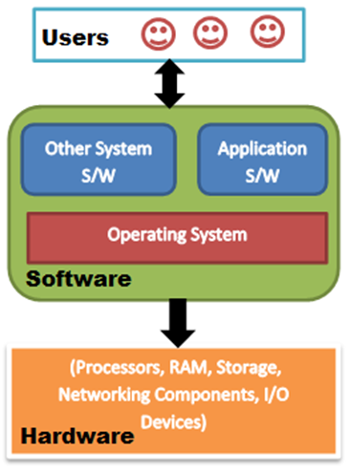
Overview of Operating System
Operating system is a software that acts as an interface between the user and the computer hardware.
It controls and manages the hardware components of the computer system based on the users and application requirements.
It provides an environment for application software and other system software to run.
Some popular Operating Systems include Linux, Windows, MacOS, VMS, OS/400, AIX, z/OS, Apple iOS and Google Android etc.
Operating systems
single user OS and multi-user OS.
CLI (Command Line Interface) and GUI (Graphical User Interface).
Illustration of an OS

Slide 13
Multi-user Operating System
Allows multiple users to access the single computer system with the help of several terminals connected through a network.
Capable of performing multiple tasks.
Shares resources of the computer system among users or tasks.
Capable of processing of tasks in the background.
Capable of utilizing multiple processors.
Manages multiple users by allowing creation of user groups, roles and permissions.
Examples: UNIX, Linux, Windows 2000, Mac OS Virtual Memory System (VMS) and Mainframe OS, etc.

Slide 14
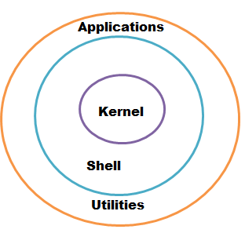
Unix Operating System
The UNIX operating system is a multiuser, multitasking operating system with widespread usage.
The basic structure of UNIX OS consists of a kernel layer, a shell layer and a utilities and applications layer.
Kernel:
The heart of the UNIX OS. Controls the hardware. Handles the process, memory, file, device and network management
Responsible for ensuring that all system and user tasks are performed concurrently.
Shell:
The interface between the user and the kernel.
Interprets the commands given by the user.
Provides programming ability to the users to write and execute shell script to perform specific tasks.
Several shells: Bourne shell (sh), C shell (csh), Korn shell (ksh) and Bourne Again shell (bash).
Each shell has own set of shell commands. Basic OS commands are the same across all the shells.
Utilities and Applications: This layer includes tools and applications that offer additional functionality to the operating system.
Basic Structure of Unix OS

Slide 15

THANK YOU Any questions…?

